Slide 1
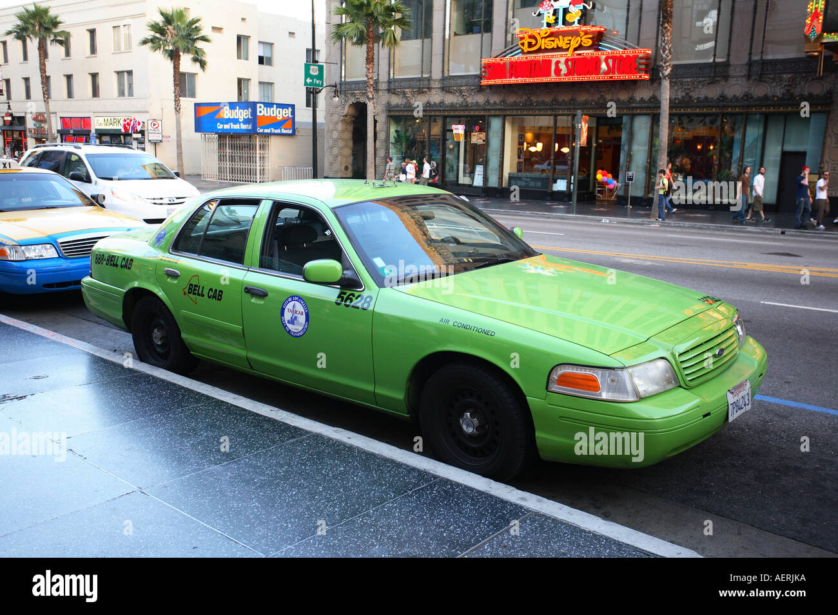
MAXIMIZING REVENUE FOR DRIVERS
NAME : GOVIND SINGH SHEKHAWAT
DATE : 9-12-2024

Slide 2

AIM OF THE PROJECT
To improve operational efficiency .
Maximizing revenue for drivers.
Optimization the techniques.
Customer satisfaction.

Slide 3

BUSINESS PROBLEM
Drivers are taking inefficient routes, which reduces earnings and increases fuel costs.
Flat pricing can cause revenue losses during peak hours and on longer rides.
Drivers miss out on peak demand times and locations, resulting in lost revenue opportunities.

Slide 4
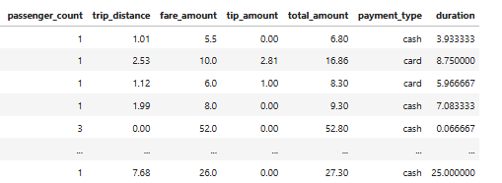
Data Overview
→ For this analysis, we utilized the comprehensive dataset of NYC green taxi trip records, used data cleaning and feature engineering procedures to concentrate solely on the relevant columns essential for our investigation.
Relevant columns used for this research :
passenger_count(1 to 5)
payment_type(card or cash)
fare_amount
tip_amount
total_amount(in $)
trip_distance
duration

Slide 5
Methodology
Data collection
Data preprocessing
Exploratory data analysis(EDA)
Statistical analysis
Hypothesis testing

Slide 6
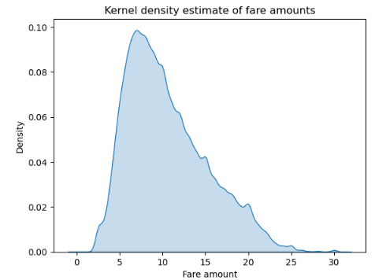
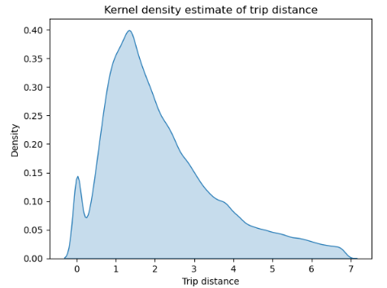
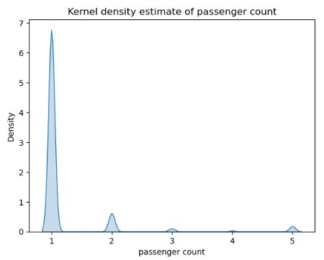
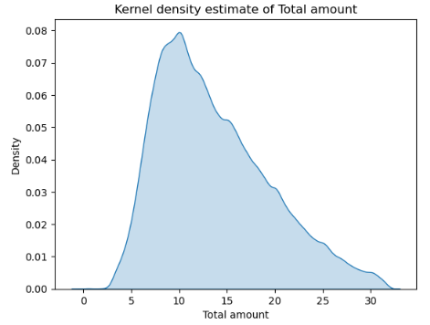
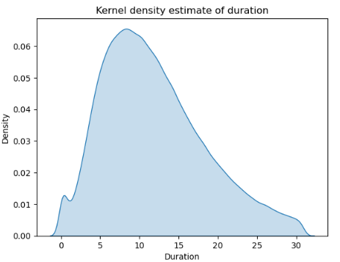
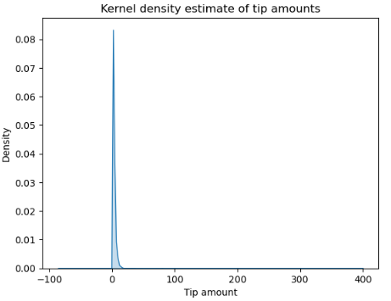
DISTRIBUTION OF DATA

Slide 7
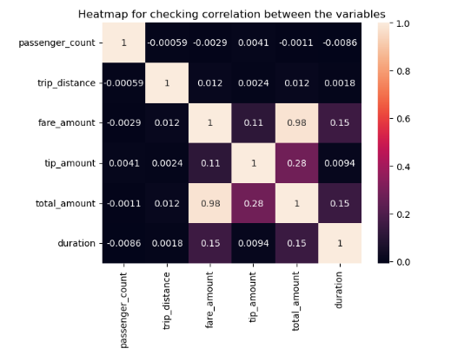
CORRELATION BETWEEN THE VARIABLES
This heatmap is representing the correlation between the variables that how one variable is affecting other

Slide 8
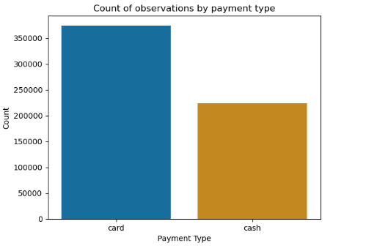
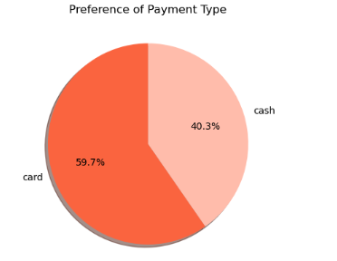
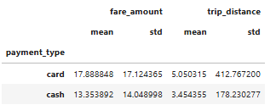
PREFERANCE OF PAYMENT MODE

Slide 9
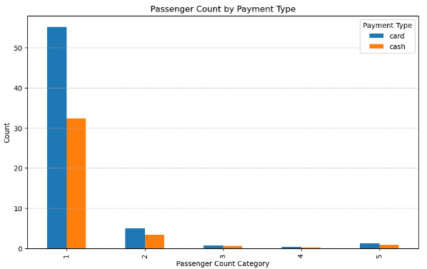
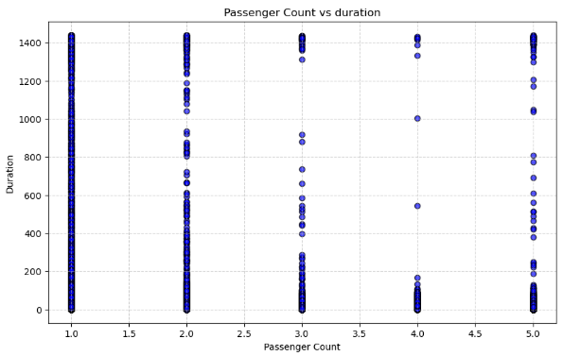
PASSENGER COUNT ANALYSIS

Slide 10
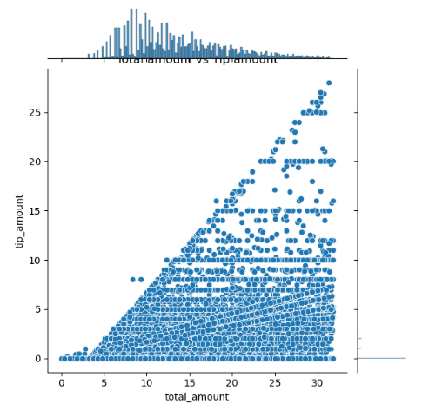
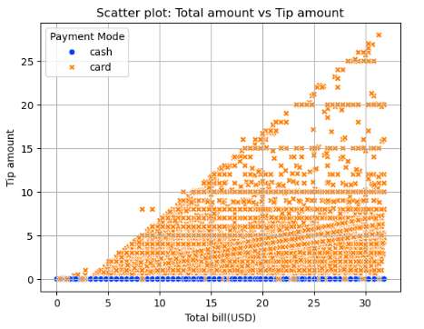
ANALYSIS ON TIP AMOUNT AND TOTAL AMOUNT

Slide 11
HYPOTHESIS TESTING
Null hypothesis : There is no difference in average fare between customers who use card and customers who use cash.
Alternative hypothesis : There is difference in average fare between customers who use card and customers who use cash.
With a T-statistic value of 42.883 and P-value of less then 0.05. We reject the null hypothesis , suggesting that there is indeed a significant difference between the average mean of customers using cash and card.

Slide 12
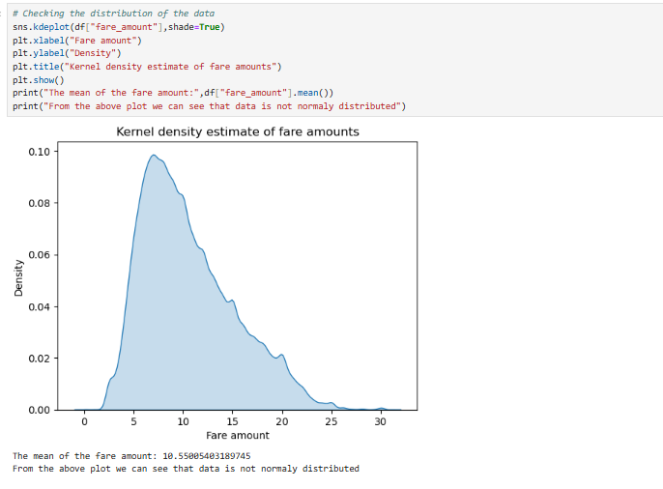
CODE :
CHECKING THE DISTRIBUTION

Slide 13
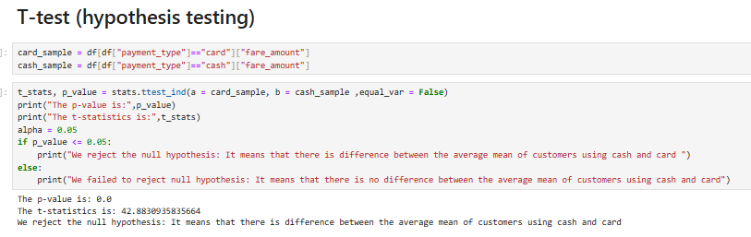

Slide 14

RECOMMENDATIONS
Encourage customers to pay with credit cards to capitalize on the potential for generating more revenue for taxi cab drivers.
Implement strategies such as offering incentives or discounts for credit card transactions to incentivize customers to choose this payment method.
Provide seamless and secure credit card payment options to enhance customer convenience and encourage adoption of this preferred payment method.

Slide 15


